Slide 1
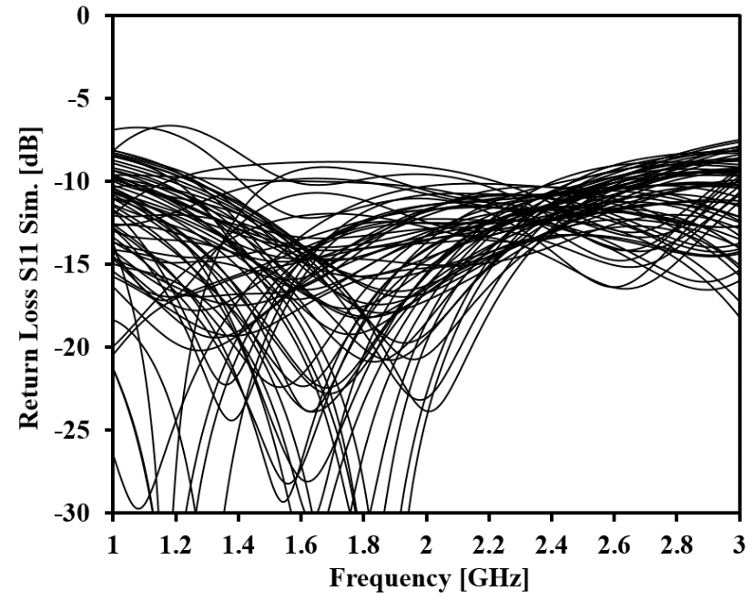
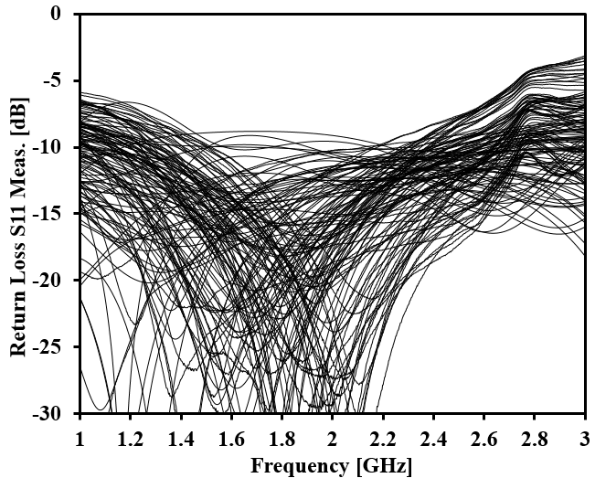
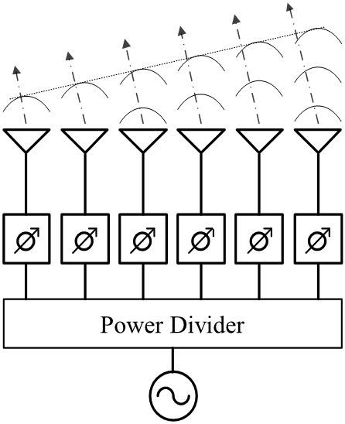
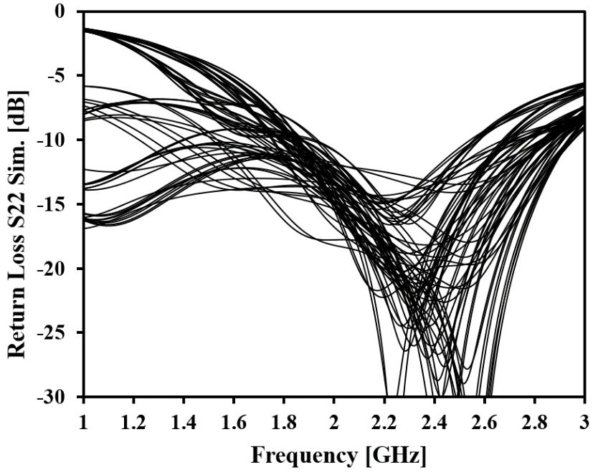
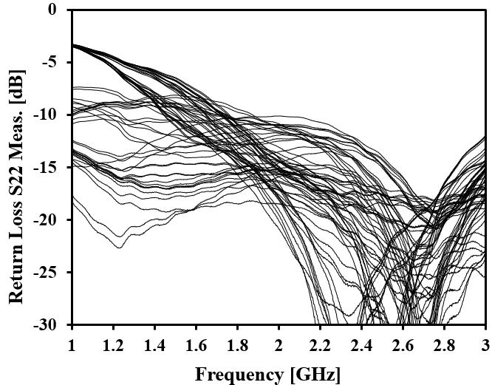
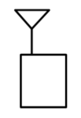
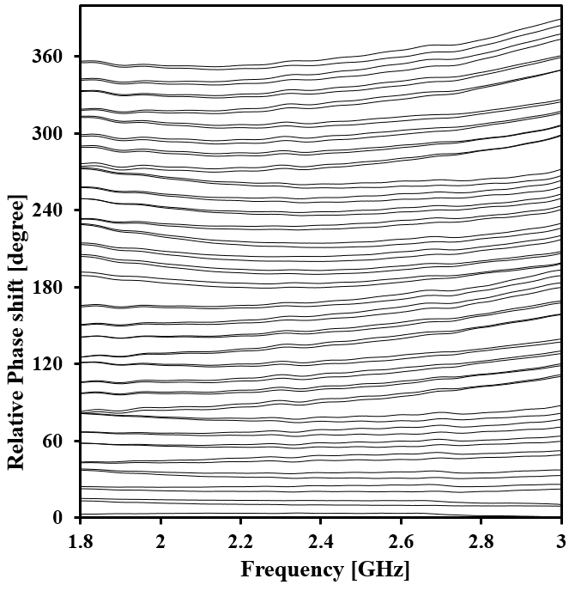
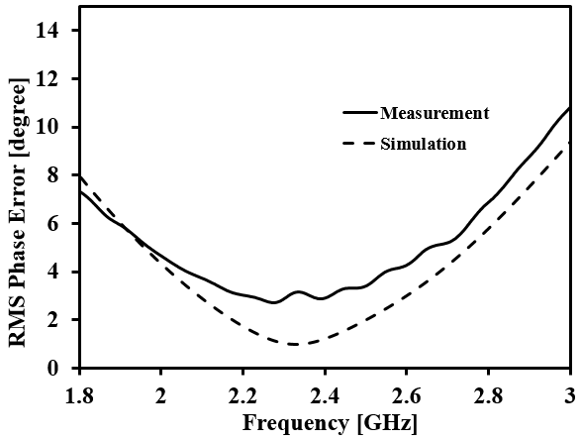
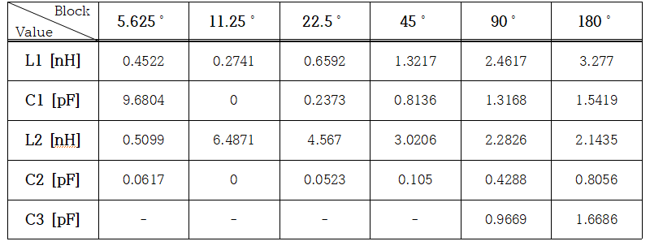
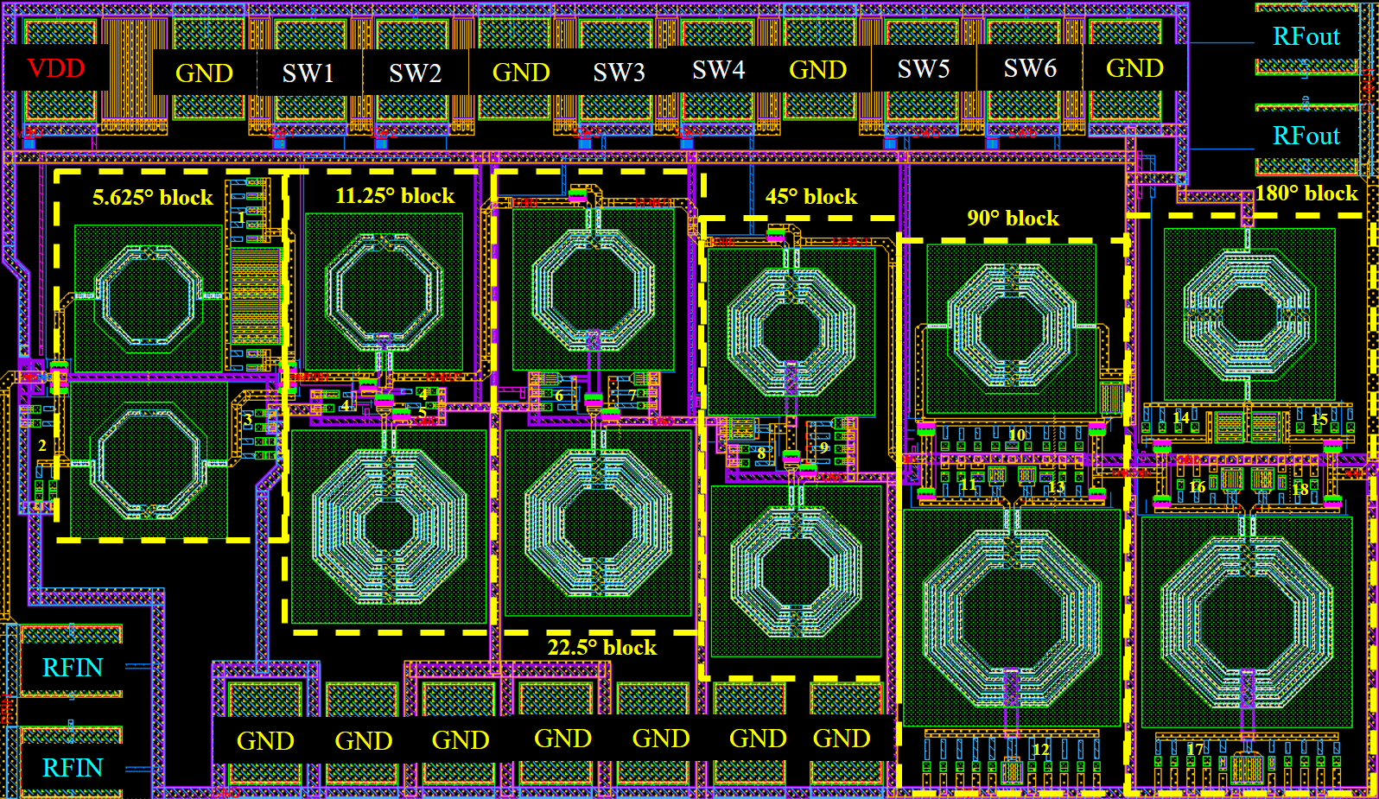
A 6-bit Phase Shifter in 65nm CMOS Technology
Tan-Binh Ngo, Ju-Hwan Lim, Wan-Su Kim, Tae-Hwan Park, Hye-Jin Choi and Sang-Woong Yoon
Electronic Engineering, Kyung Hee University
E-mail : sangwyoon@khu.ac.kr
Abstract
Simulation Measurement
The 6-bits switched network type phase shifter in Samsung 65nm CMOS technology is presented in this paper. The presented phase shifter is using the LC filter topologies to implement the phase shift blocks for compact size rather than using trans-mission line. For 64-states, the insertion loss is -9.7 ±1.5dB and return losses are under 10dB. The RMS phase error and RMS amplitude error are less than 4° and 0.87dB in 2GHz – 2.5GHz bandwidth, respectively. The die area is 1.4×0.81${um}^{2}$ including pads with 0mW DC power consumption
S11 [dB]
Sim. | < -10dB @ 2~2.5GHz
Meas. | < -10dB @ 1.6~2.4GHz
S22 [dB]
Sim. | < -10dB @ 1.8~2.6GHz
Meas. | < -10dB @ 1.8~3GHz
PHD
Introduction
S21 [dB]
Sim. | -9$±2$dB @ 2.4GHz
Meas. | -9.5$±$1.5dB @ 2.4GHz
- Overall 6-bits Phase Shifter Schematic
- Measured Phase shift of 64 states
- Measured and calculated
RMS Phase error.
- Layout of 6-bits Phase Shifter
III. Conclusions
A 6-bits phase shifter fabricated in 65nm CMOS technology was presented. The phase shifter is using switched network method with inductor and capacitor to reduce an overall size. The chip size is 1403×814〖um〗^2 including all pads. The operation bandwidth is 2.0 – 2.5GHz. The RMS phase error and The RMS amplitude error are less than 4° and 0.87dB in operation bandwidth for 64-states, respectively. The return losses at input and output are under 10dB and the insertion losses for 64-states are 9.7±1.5dB with zero DC power consumption.
Implementation and Measurement results
- Simulation, Measurement Results
 | Simulation | Measurement
Supply voltage | 1 V | 1 V
Controll voltage | 1 V | 1 V
Resolution | 6 bits (5.625° step) | 6 bits (5.625° step)
Current consumption | 0 | 0
port matching | < -10 dB @ 2~2.5GHz | <-10 dB @1.8~2.4GHz
Gain | -9 $±$ 2dB | -9.5 $±$ 1.5dB
RMS Phase Error | < 3° @ 2.1~2.6GHz | < 4° @ 2~2.5GHz
Acknowledgments
This work was supported by Basic Science Research Program through the National Research Foundation of Korea (NRF) funded by the Ministry of Education, Science and Technology (2017R1A2B4002134), by the MSIP (Ministry of Science, ICT and Future Planning), Korea, under the ITRC (Information Technology Research Center) support program (IITP-2020-2016-0-00291) supervised by the IITP (National IT Industry Promotion Agency), and by X-mind Corps program of National Research Foundation of Korea (NRF) funded by the Ministry of Science, ICT & Future Planning (2017H1D8A1031522). The chip fabrication and EDA tool were supported by the IC Design Education Center (IDEC), Korea.

